Slide 1


Hotel Database Management System
Team Members: Anwesha Sinha, Protima Tarafdar, Gandharva Dua, Armando Miranda, Seonhee Joo

Slide 2
agenda
Overview
The er diagram
Relational schema
The data
The queries
The results
Visualization
conclusion

Slide 3

Overview
Given the new challenges and expectations brought-forth by COVID-19 our hotel has decided to implement a new database management system that can help us allocate our resources more effectively
The system is expected to improve these aspects of our hotel management by automating certain processes such as the allocation of staff for any given service, allocating parking spots for all customers. This new system will also help us in keeping track of our physical resources such as which rooms are free/occupied, which parking slots are available, which staff member performed which service and so on.
Additionally, the system will allow us to keep track of our customer’s experience in our facilities with a rating score answered prior to check-out.
All these new measures will help us better track our strengths and weaknesses and act accordingly on a timelier manner.

Slide 4
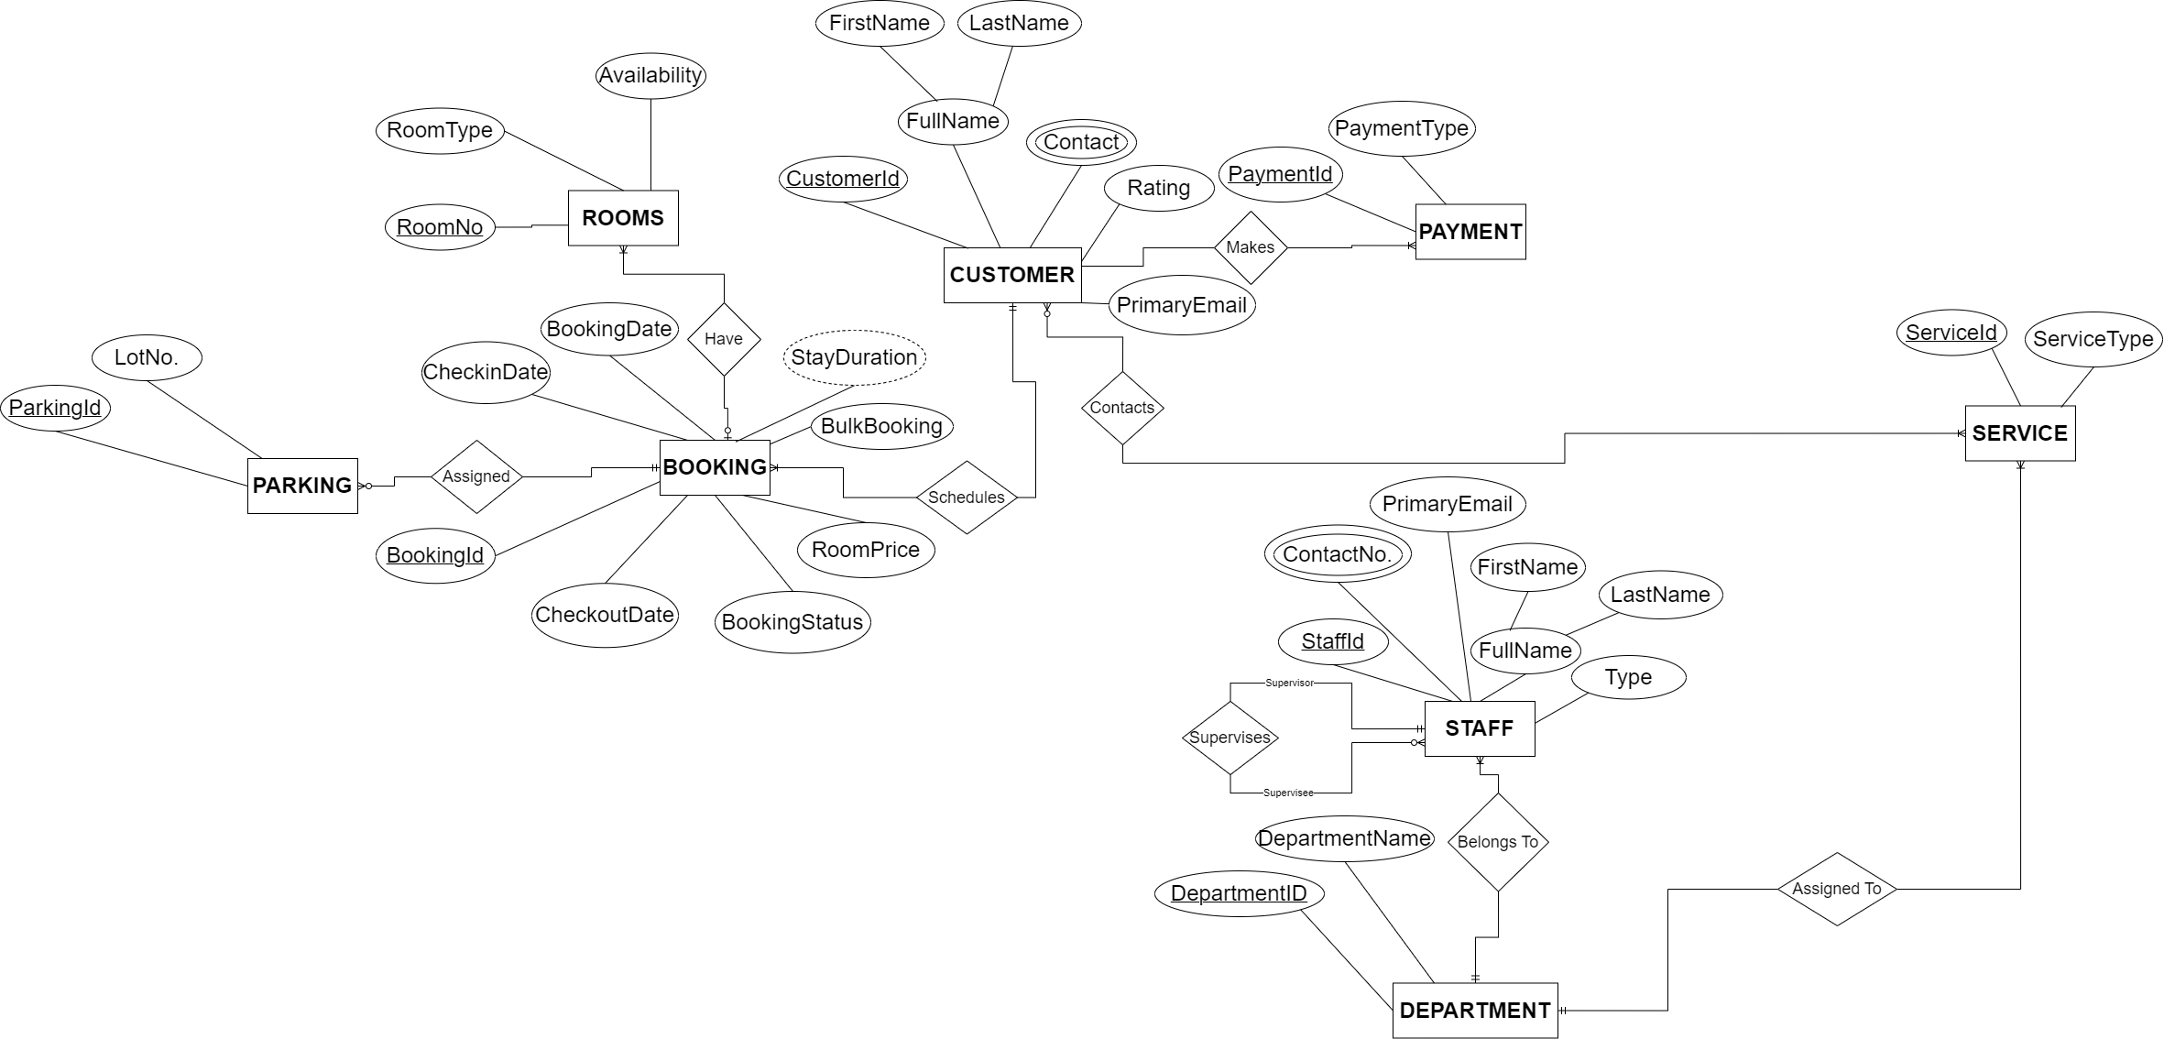
Entity relationship diagram
Assumptions Made:
Each customer brings at most one vehicle
Services are included in the overall booking price, not separately
Services are firstly requested to the department, and this later assigns a staff member to perform such service

Slide 5
Relational schema Mapping
1. CUSTOMER : Customerid, FirstName, LastName, Rating, PrimaryEmail, Bookingid[FK], ServiceID[FK] CONTACT: Contact, Customerid[FK]
2. BOOKING: Bookingid, CheckinDate, CheckoutDate, BookingDate, BulkBooking, RoomPrice, BookingStatus, Customerid[FK]
3. CUSTOMER-BOOKING: CUSTOMERID[FK], BOOKINGID[FK]
4. ROOMS: RoomNo, RoomType, Availibility, Bookingid[FK]
5. PARKING: Parkingid, LotNo., Bookingid[FK]
6. PAYMENT: PaymentID, PaymentType, Customerid[FK]
7. STAFF: Staffid, PrimaryEmail, FirstName, LastName, Serviceid[FK], DepartmentID[FK]
StaffContact: ContactNo., Staffid[FK]
8. DEPARTMENT: DepartmentID, DeparmentName
9. SERVICE: Serviceid, ServiceType, DepartmentID[FK]

Slide 6
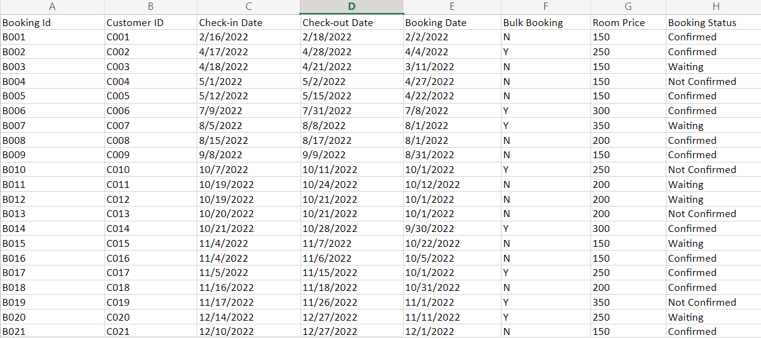
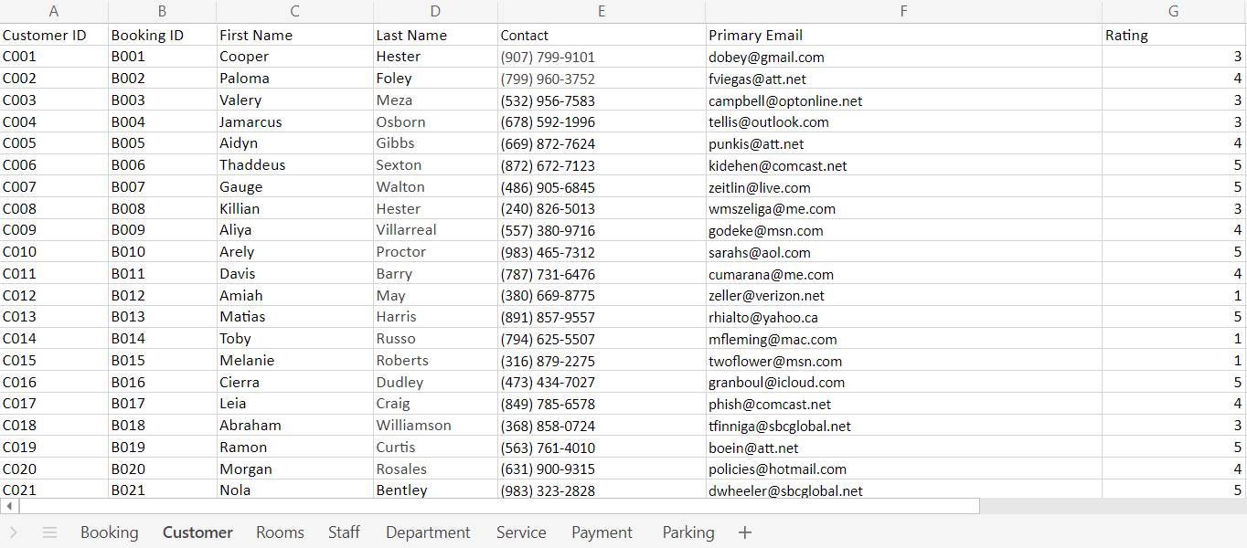
DATA Source(s)
A few snapshots of the tables
Data was initially created using Mockaroo
but it wasn't catering to the data type needed.
In the end, the data was manually generated with values which were a better fit for the envisioned business.

Slide 7
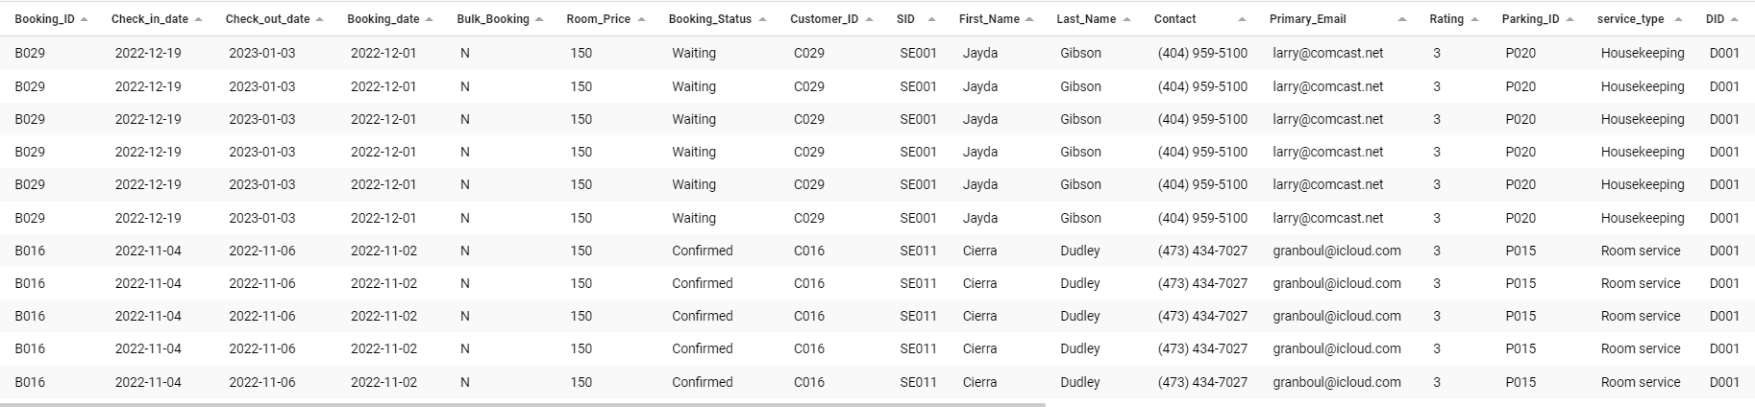
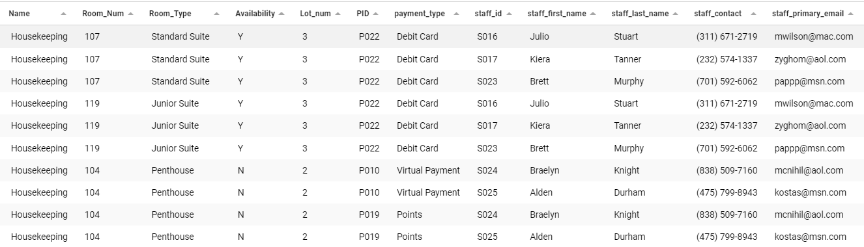
QUERIES/REPORTS - Analytical database
This is to join tables in our Hotel database to generate reports for our project/project framing.

Slide 8
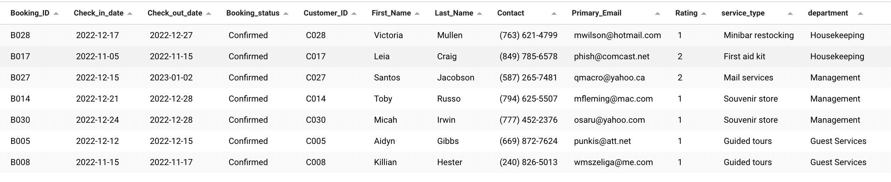
QUERIES/REPORTS No.1
1. Show the customer, booking information and service they are availing where status is ‘Confirmed’ and rating is less than 3?
with ADS as (
select
b.Booking_ID, b.Check_in_date, b.Check_out_date, b.Booking_status, c.Customer_ID, c.First_Name,c.Last_Name, c.Contact, c.Primary_Email, c.Rating,
s.type as service_type, d.name as department
from Customer_booking cb
join Booking b on cb.Booking_ID = b.Booking_ID
join Customer c on cb.Customer_ID = c.Customer_ID
join Service s on c.sid = s.SID
join Department d on s.DID = d.did
)
select * from cte where Booking_status = 'Confirmed' and Rating < 3

Slide 9
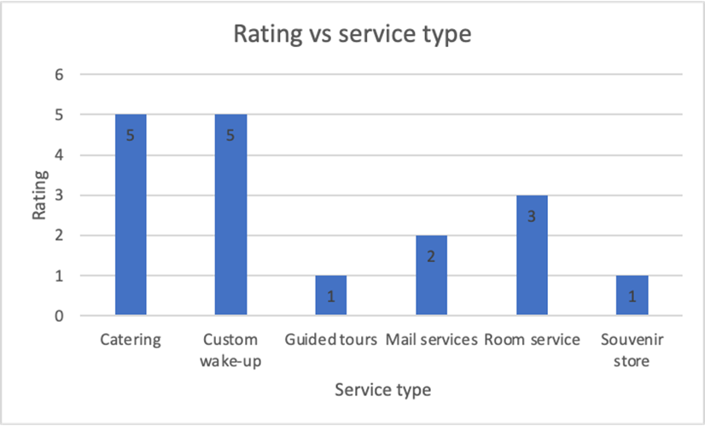
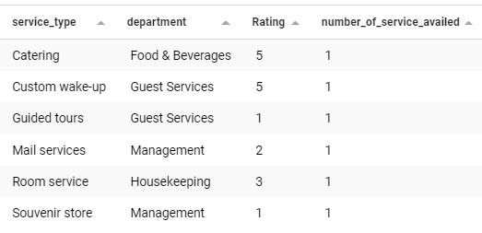
QUERIES/REPORTS No.2
2. Show when different types of departments are called and service availed by the customer and their rating where booking status is ‘Confirmed’
with ADS as (
select
b.Booking_ID, b.Check_in_date, b.Check_out_date, b.Booking_date, b.Bulk_Booking, b.Room_Price, b.Booking_Status,
c.Customer_ID, c.SID, c.First_Name, c.Last_Name, c.Contact, c.Primary_Email, c.Rating, c.Parking_ID,
s.Type as service_type,s.DID,
d.Name,
r.Room_Num,r.Room_Type,r.Availability,
p.Lot_num,
py.PID,py.Type as payment_type,
st.staff_id,
st.first_name as staff_first_name,st.last_name as staff_last_name,
st.contact as staff_contact,st.primary_email as staff_primary_email
from Customer_booking cb
join Booking b on cb.Booking_ID = b.Booking_ID
join Customer c on cb.Customer_ID = c.Customer_ID
join Service s on c.sid = s.SID
join Department d on s.DID = d.did
join Rooms r on r.Booking_ID = b.Booking_ID
join Parking p on p.Booking_ID = b.Booking_ID
join Payment py on py.Customer_ID = c.Customer_ID
join staff st on st.sid = s.sid and st.did = d.did
where booking_status = 'Confirmed'
)
select distinct service_type,name as department,rating, count(distinct customer_id) as number_of_service_availed
from ads
group by service_type,name,rating

Slide 10
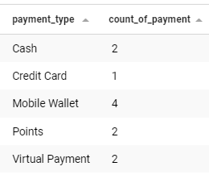
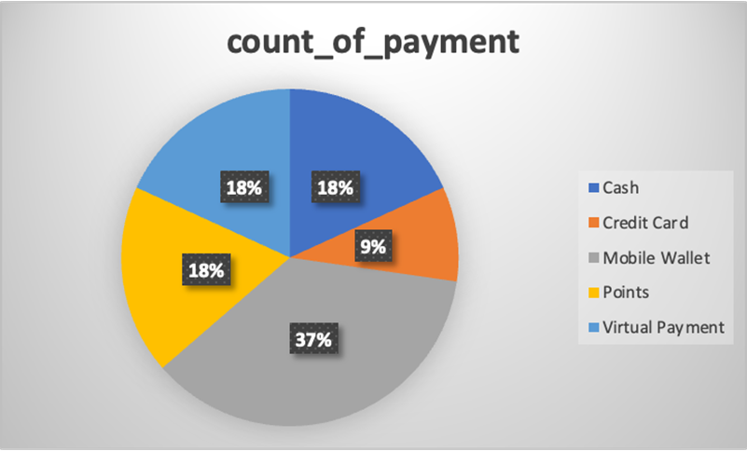
QUERIES/REPORTS No.3
3. Show how many times a payment method is used while checking out?
with ADS as (
select
b.Booking_ID,b.Check_in_date,b.Check_out_date,b.Booking_date,b.Bulk_Booking,b.Room_Price,b.Booking_Status,
c.Customer_ID,c.SID,c.First_Name,c.Last_Name,c.Contact,c.Primary_Email,c.Rating,c.Parking_ID,
s.Type as service_type,s.DID,
d.Name,
r.Room_Num,r.Room_Type,r.Availability,
p.Lot_num,
py.PID,py.Type as payment_type,
st.staff_id,
st.first_name as staff_first_name,st.last_name as staff_last_name,
st.contact as staff_contact,st.primary_email as staff_primary_email
from Customer_booking cb
join Booking b on cb.Booking_ID = b.Booking_ID
join Customer c on cb.Customer_ID = c.Customer_ID
join Service s on c.sid = s.SID
join Department d on s.DID = d.did
join Rooms r on r.Booking_ID = b.Booking_ID
join Parking p on p.Booking_ID = b.Booking_ID
join Payment py on py.Customer_ID = c.Customer_ID
join staff st on st.sid = s.sid and st.did = d.did
where booking_status = 'Confirmed'
)
select distinct payment_type, count(distinct booking_id) as count_of_payment
from ads
group by payment_type

Slide 11
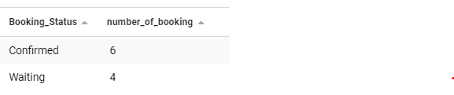
QUERIES/REPORTS No.4
4. Show the total Number of booking for different type booking status?
with ADS as (
select
b.Booking_ID,b.Check_in_date,b.Check_out_date,b.Booking_date,b.Bulk_Booking,b.Room_Price,b.Booking_Status,
c.Customer_ID,c.SID,c.First_Name,c.Last_Name,c.Contact,c.Primary_Email,c.Rating,c.Parking_ID,
s.Type as service_type,s.DID,
d.Name,
r.Room_Num,r.Room_Type,r.Availability,
p.Lot_num,
py.PID,py.Type as payment_type,
st.staff_id,
st.first_name as staff_first_name,st.last_name as staff_last_name,
st.contact as staff_contact,st.primary_email as staff_primary_email
from Customer_booking cb
join Booking b on cb.Booking_ID = b.Booking_ID
join Customer c on cb.Customer_ID = c.Customer_ID
join Service s on c.sid = s.SID
join Department d on s.DID = d.did
join Rooms r on r.Booking_ID = b.Booking_ID
join Parking p on p.Booking_ID = b.Booking_ID
join Payment py on py.Customer_ID = c.Customer_ID
join staff st on st.sid = s.sid and st.did = d.did
)
select distinct booking_status, count(distinct booking_id) as number_of_booking from ads
group by booking_status

Slide 12
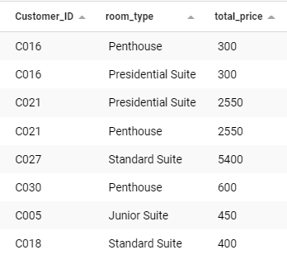
QUERIES/REPORTS No.5
5.Show total price paid by the customers for staying in different type of rooms during their stay?
with ADS as (
select
b.Booking_ID,b.Check_in_date,b.Check_out_date,b.Booking_date,b.Bulk_Booking,b.Room_Price,b.Booking_Status,
c.Customer_ID,c.SID,c.First_Name,c.Last_Name,c.Contact,c.Primary_Email,c.Rating,c.Parking_ID, s.Type as service_type,s.DID,
d.Name, r.Room_Num,r.Room_Type,r.Availability, p.Lot_num,
py.PID,py.Type as payment_type,
st.staff_id, st.first_name as staff_first_name,st.last_name as staff_last_name,
st.contact as staff_contact,st.primary_email as staff_primary_email
from Customer_booking cb
join Booking b on cb.Booking_ID = b.Booking_ID
join Customer c on cb.Customer_ID = c.Customer_ID
join Service s on c.sid = s.SID
join Department d on s.DID = d.did
join Rooms r on r.Booking_ID = b.Booking_ID
join Parking p on p.Booking_ID = b.Booking_ID
join Payment py on py.Customer_ID = c.Customer_ID
join staff st on st.sid = s.sid and st.did = d.did
)
,cte as(
select distinct customer_id, check_in_date,check_out_date,room_type,room_price
,TIMESTAMPDIFF(day, check_in_date, check_out_date) AS DateDiff
from ADS
where booking_status = 'Confirmed'
)
select c.Customer_ID,c.room_type,(c.room_price*c.datediff) as total_price from cte c

Slide 13
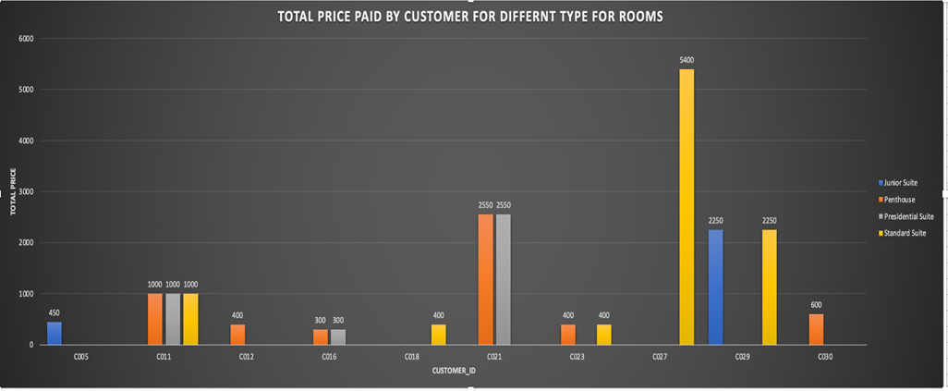
VISUALIZATION​

Slide 14

CONCLUSION
To allocate our resources more effectively, we created the database for staffing, services, parking spots aligned with customers' booking or requests which will improve work efficiency.
Especially, queries we use for our business analysis, it would help us to define a new business strategy based on the hotel stay or booking patterns.
Also, the system will allow us to keep track of our customer’s experience in our facilities with a rating score answered prior to check-out and we accommodate this to enhance our customer satisfaction.
Automation of some of our operations using this new business management system will allow our hotel to better keep track of the different activities that take place as to drill down in the required level when diagnosing our business model.
All these new measures will help us better track our strengths and weaknesses and act accordingly on a timelier manner.
Our database is only accounting for a single hotel, and we simplified some tables such as only one car and one service per customer

